Slide 1
OFDM Simulation
方宣翔

Slide 2
Handwriting report
AWGN channel

Slide 3
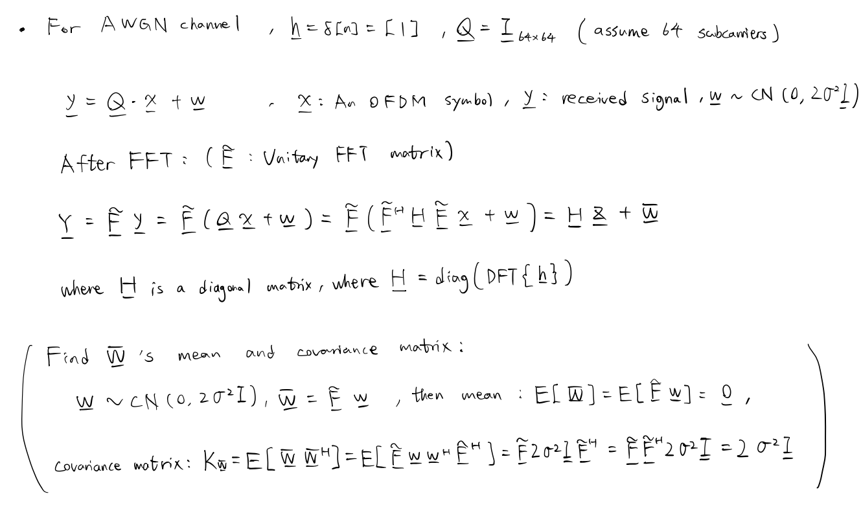

Slide 4
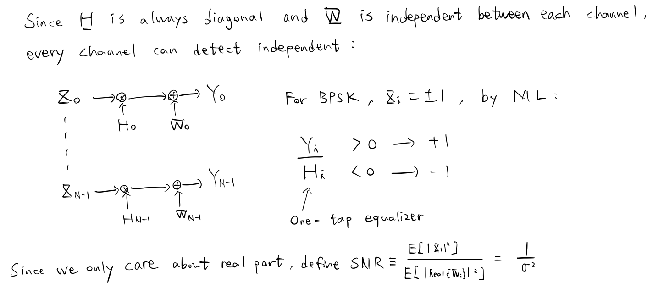

Slide 5
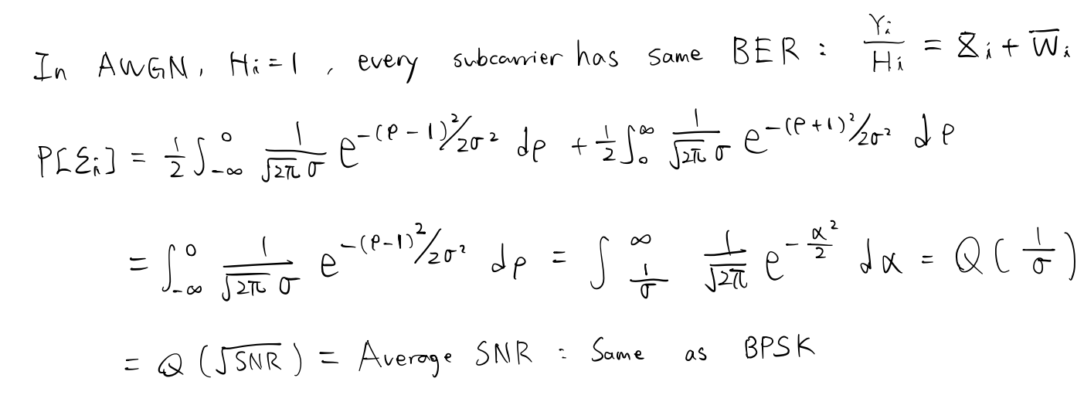

Slide 6
Simulation result
AWGN channel

Slide 7
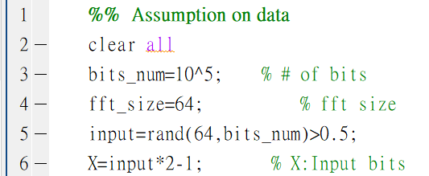
Assumption on OFDM system
Number of bits on each channel : 10^5
Bits: +-1.
FFT size: 64
Matlab code:

Slide 8
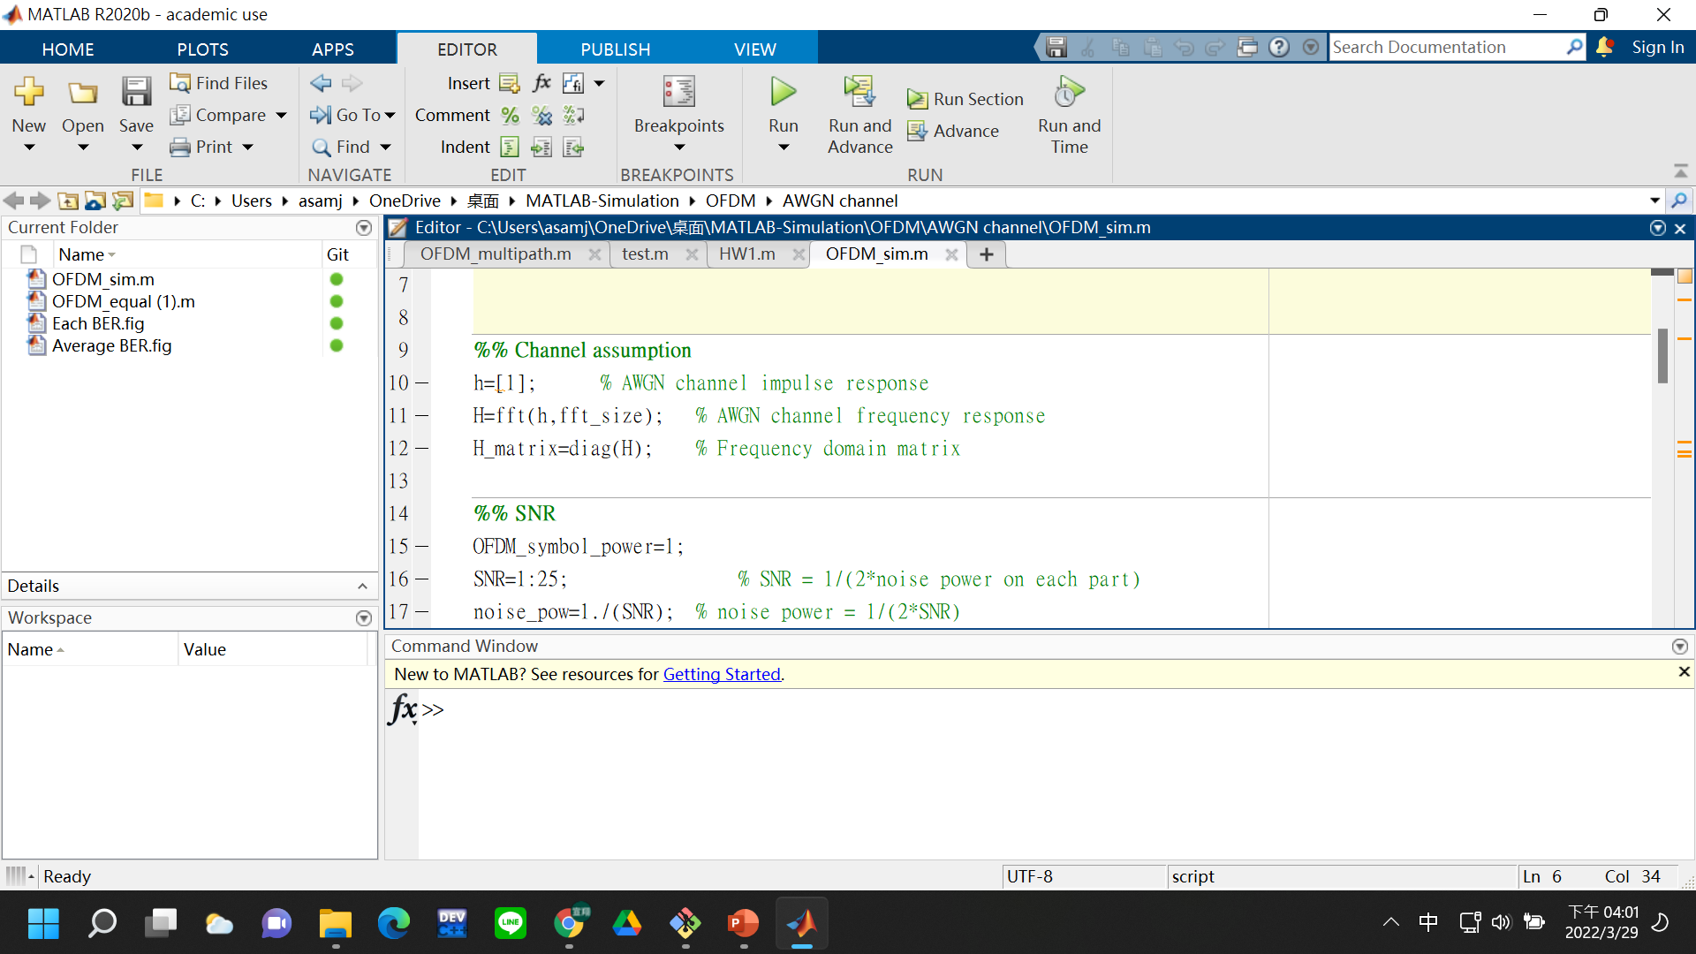
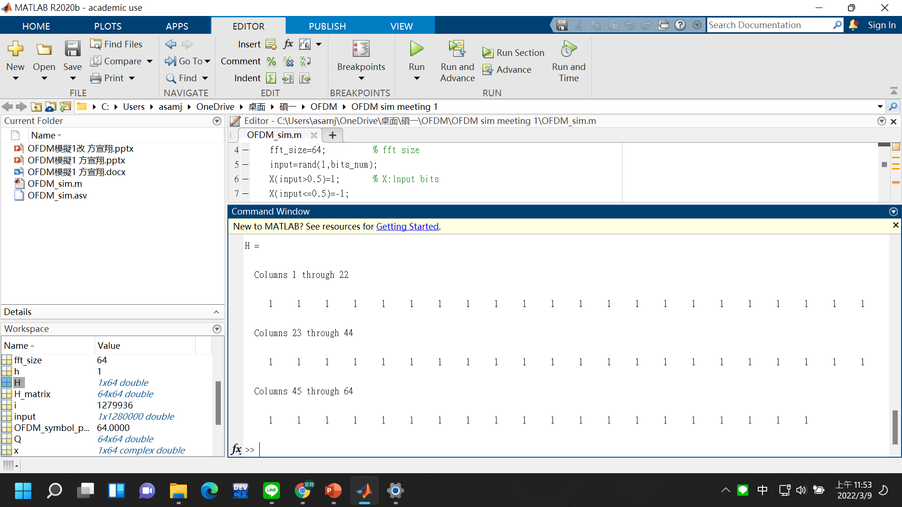
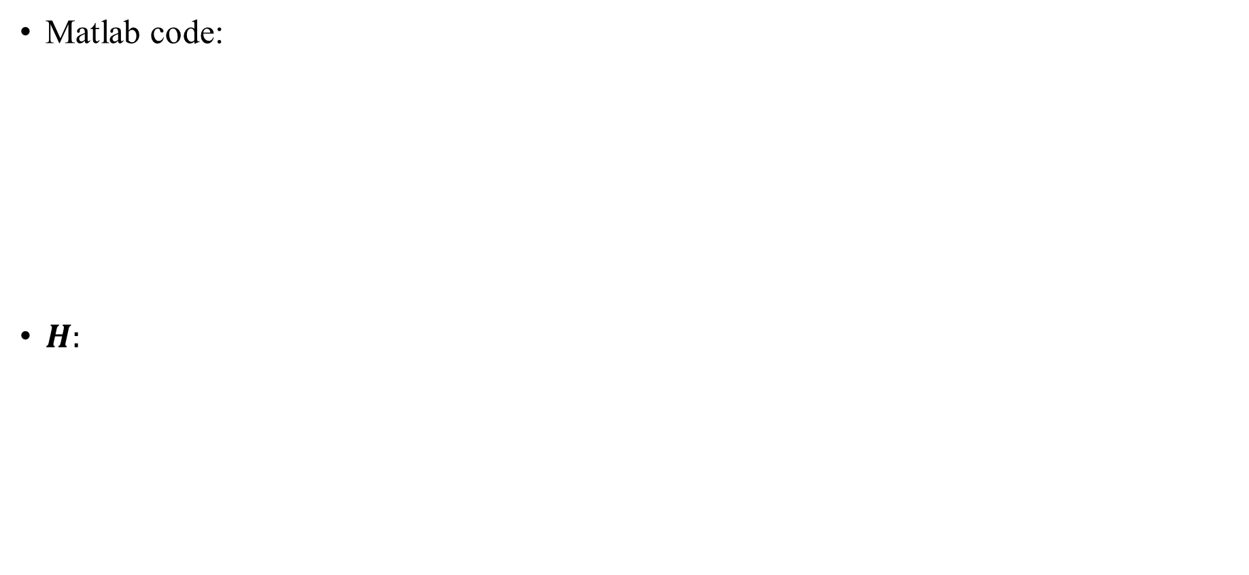
AWGN channel
Matlab code:
$H:$

Slide 9
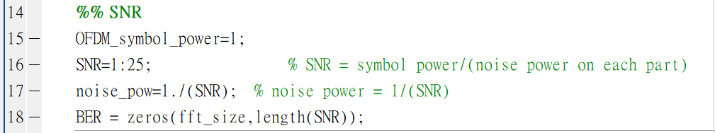
SNR
Assumption on SNR: 1:25 (Linear scale)
Matlab code:

Slide 10
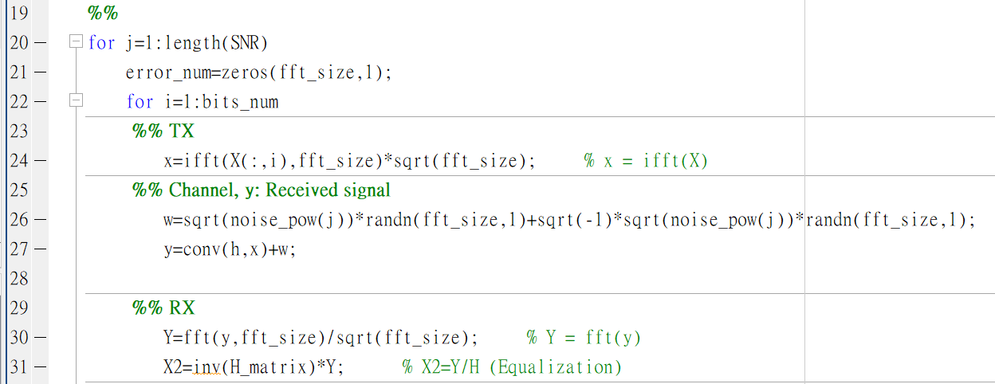
Modulation and demodulation

Slide 11
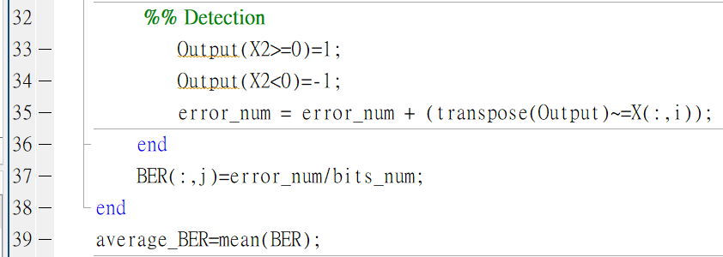
Detection

Slide 12
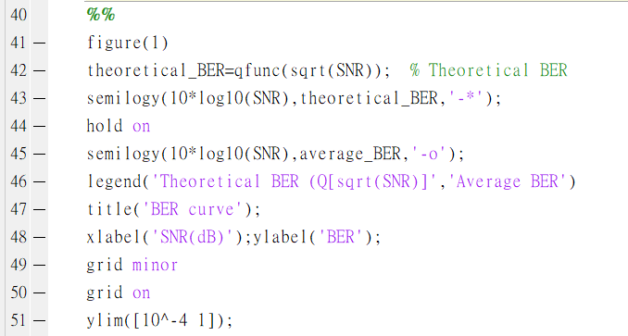
Average BER curve

Slide 14
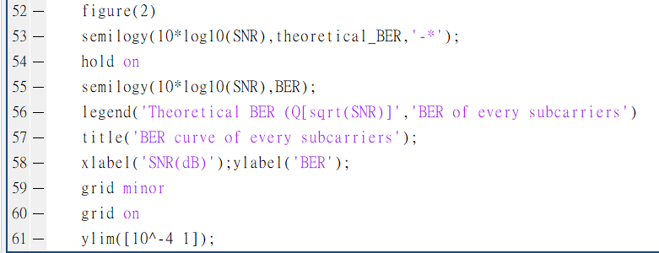
BER curve of each channel

Slide 16
Handwriting report
Multipath channel

Slide 17
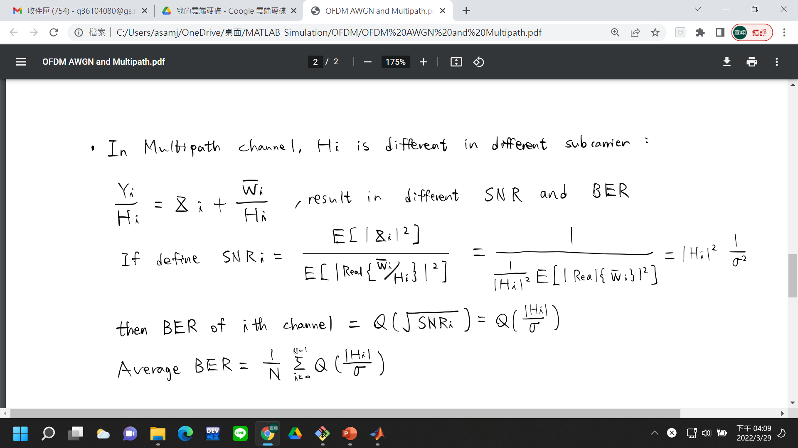

Slide 18
Simulation result
AWGN channel

Slide 19
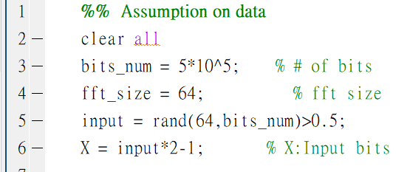
Assumption on OFDM system
Number of bits on each channel: 5*10^5
Bits: +-1.
FFT size: 64
Matlab code:

Slide 20
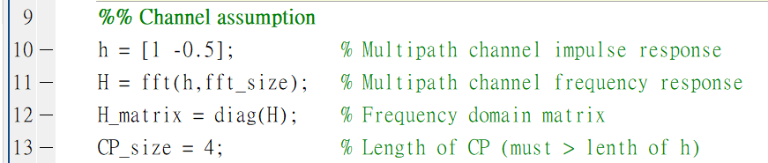
Multipath channel
Matlab code:

Slide 22
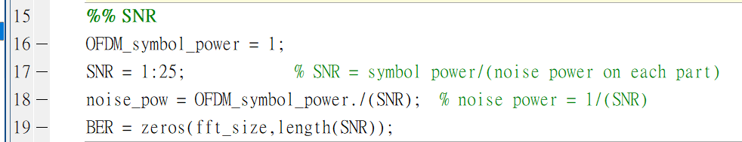
SNR
Assumption on SNR: 1:25 (Linear scale)
Matlab code:

Slide 23

Modulation and demodulation

Slide 24
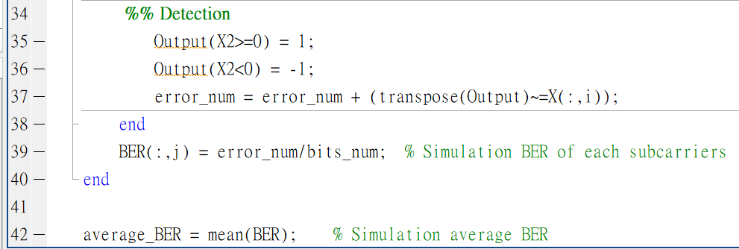
Detection

Slide 25
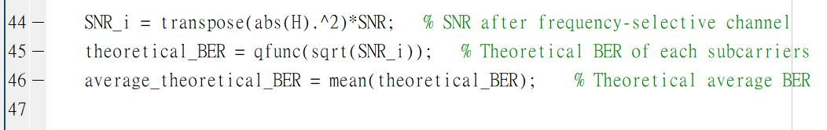
Theoretical BER

Slide 26
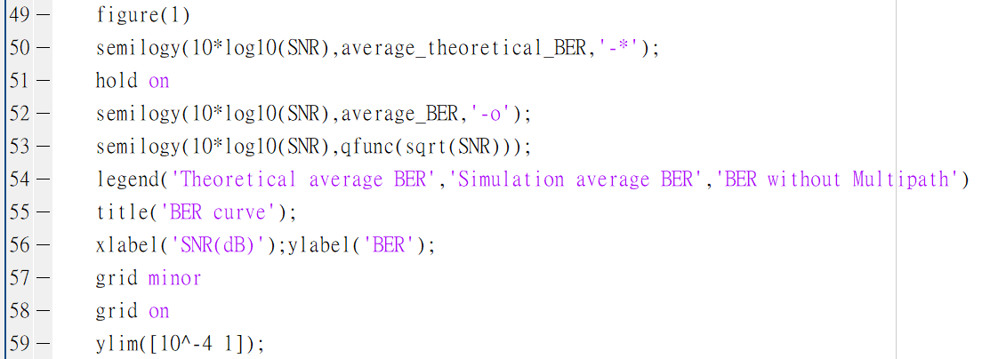
Average BER curve

Slide 28
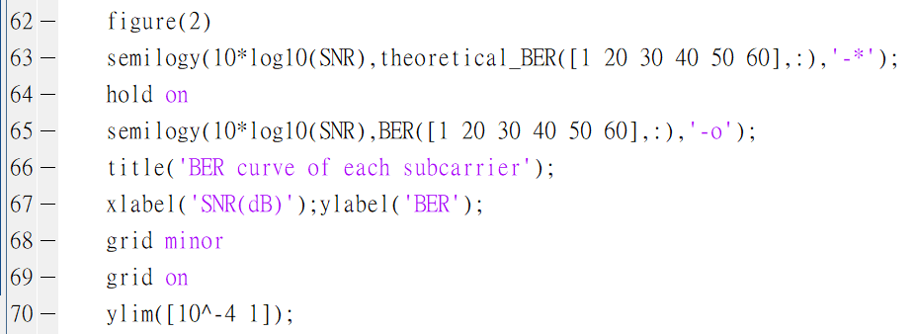
BER curve of each channel

Slide 30
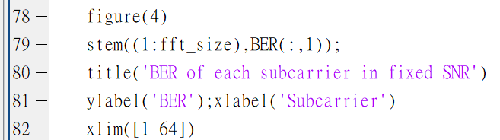
BER of each subcarrier in fixed SNR

